Slide 1


Slide 2
Purpose of Science?
Science: The process to get information from the universe and everything that happened, happening, or going to happen around us.
Science can be studied or observed through methods, logic, rationalism, empiricism, hypothesis, etc.
The purpose of science is to figure out how it all works. How does it evolve? How does it collapse?
To answer the above-mentioned questions, we normally categorize things in different fields which the scientists gave different names.

Slide 3


Introduction to Science
Natural Sciences
Management Sciences
Science
Social Sciences
Computer Sciences

Slide 4


Categorization of Science
Natural Sciences
Management Sciences
Computer Sciences
Social Sciences
Zoology
Botany
Physics
Chemistry
Geology
Administration
Accounting
Marketing
Business
Finance
Data Science
Software Engineering
Cyber Security
Anthropology
Sociology
Economics
Political Science
History
Psychology

Slide 5
Importance of Social Sciences
Unlike other sciences, Social science has a broader aspect to perceive the activities around. Other sciences are too specific in nature but social sciences are broader and general in nature.
Social Sciences (Society is the lab for social scientists) World War 1, conferences, League of nations
The study of Human behavior is called Anthropology
The study of the Past is called History
The study of region is called Geography
The study of society is called Sociology

Slide 6
Social Sciences is all about…
Various Ages- Ancient civilizations
Continents- Europe, Asia, Africa
Regions- South Asia, Indo-Pak
Countries- Pakistan, Afghanistan, India
Movements- Khilafat Movement, Pakistan Movement
Personalities- Hazrat Muhammad PBUH, Quaid-i-Azam, Martin Luther
Institutions- Feudalism, Capitalism
Themes and Issues- Ethnic diversity, Religious diversity
Revolutions- French Revolution, Iranian Revolution, and Industrial Revolutions
Wars- World war I&II, Indo-Pak Wars

Slide 7
The Purpose of Social Sciences
According to Professor Cary Cooper “We have all great Science in the world. We have the greatest climate change, medical research on Cancer like a disease but we do not have social ethics/Human behavior to respond to the crises”.
Social Science is about behavior changing whether that is Psychology, Sociology, Political Science, Philosophy, Economics, and so on.
The purpose of science is an advancement towards life or we can say to facilitate human beings.
To answer the questions like how to get man turn up? How to change the behavior of a man? How do we change people’s attitude towards sustainability, humanity, etc. we need to study social sciences.
Social Sciences can give a proper path and direction because they are all about social ethics.

Slide 8
Understanding Social Sciences
Our pattern of perception of how things are in our lives has been termed worldview.
Our worldview has a major influence on our future because it informs the institutions we make today.
Anthropocentrism and Theo-centrism are two opposing worldviews that influence humanity’s relationship with ecology.

Slide 9
History of Human Beings
According to Theo-centrists, Hazrat Adam (AS) was the first Human Being, and most probably, human history can be traced to Adam.
Responding to Theo-centrists, the Anthropo-centrists brought the theory of evolution (Darwinism) according to which the history of human beings can be traced from chimpanzees that had evolved with time and consequently got their perfect evolution in terms of Human Beings.
Most Philosophers have different interpretations regarding human history.

Slide 10
Karl Marks’ Classes of History
Primitive Communism (a stage of history without any class struggle, Age of survival)
Slavery (a stage of history with the class struggle between slaves and slaveowners, Accumulation of power)
Feudalism (a stage of history with a class struggle between peasants and feudal lords)
Capitalism (a stage of history with the class struggle between the proletariat and bourgeoisie/capitalists)
Advanced Communism (the final stage of human history, which was yet to come, with a classless society and stateless society)

Slide 11
Purposes of History
Commemorative Purpose: To preserve the memory of past events, especially the deeds and achievements of ancestors, heroes, leaders, and kings.
Moralistic Purpose: To record the past events so that future generations could draw or learn lessons from them, and thus avoid repeating the past errors.
Propagation of views: To propagate and disseminate or spread particular views, beliefs, and doctrines in which the historians believe. These views may include, among others, religious/ideological or political ideas.
Propaganda: History may also be written with the purpose of propaganda among the intended readers such as glorifying the successes and achievements of kings or rulers while minimizing their failures.
Explanatory purpose: According to Mary Fulbrook, the “processes of historical investigation and representation are about making sense of the past… Making sense means imposing categories, looking for patterns, searching for connections, seeking answers to questions, imbuing the past with meaning.”

Slide 12
Emergence of Civilizations
Paleolithic: The Paleolithic era is a period from around 3 million to around 12,000 years ago. It is the era when humans first invented stone tools.
Neolithic: The Neolithic era is a period from about 12,000 to around 2,000 years ago. It is the era when humans started farming to fulfill their basic needs.

Slide 13
Ancient Civilizations
In the course of human evolution, the practice of living in a group with mutual understanding and dependency has become a very useful and practical lifestyle, and from small isolated groups, larger communities have formed. Then came societies which in time became civilizations.

Slide 14
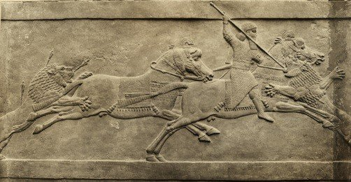
The Mesopotamian Civilization
Civilization Name: Mesopotamian civilization
Period: 3500 BC–500 BC
Original Location: Northeast by the Zagros
Current Location: Iraq, Syria, and Turkey
Meaning: Land between rivers (ancient Greek)
Major Highlights: First civilization in the world

Slide 15
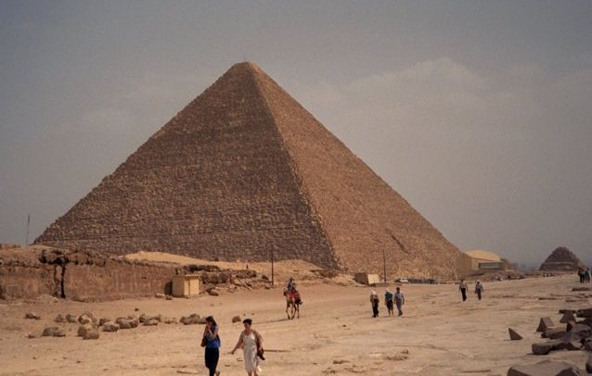
The Ancient Egyptian Civilization
Civilization Name: Egyptian civilization
Period: 3150 BC–30 BC
Original Location: Banks of the Nile
Current Location: Egypt
Major Highlights: Construction of pyramids

Slide 16
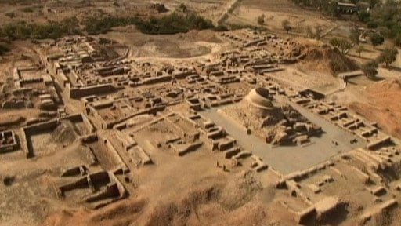
The Indus Valley Civilization
Civilization Name: Indus Valley civilization
Period: 3300 BC–1900 BC
Original Location: Around the basin of the Indus River
Current Location: Northeast Afghanistan
to Pakistan and northwest India
Major Highlights: One of the most widespread
civilizations, covering 1.25 million km

